Slide 1
DBMS TERM PROJECT
LLM SQL
Heap Undercut

Slide 2
TABLE OF CONTENTS
01
02
03
METHODOLOGY
INTRODUCTION & OBJECTIVE
RESULTS & CONCLUSION

Slide 3
Our Team
Atul Jayesh 21CS10012
Barun Parua 21CS10014
Owais Ahmad Lone 21CS10048
Ranjim Prabal Das 21CS10054
Navaneeth Shaji 21CS30032

Slide 4
Introduction
The primary objective of our Project "LLM SQL" was to train a general LLM with enough text queries and their corresponding SQL so that it can generate proper SQL queries on its own when given simple English Language Queries. As we know that LLMs are pretty good at generating Natural Language responses(e.g ChatGPT) and given the low scope for error in this task, we wanted to take that a step further to finetune LLMs to this specific task of generating SQL queries accurately.

Slide 5
Methodology
The methodology we chose is in fact the most popular one when dealing with LLMs:
Fine tuning for a downstream task given they already understand natural language text very well
We did not freeze any portion of the model parameters to train as many of them as possible for a better fit
We decided to train the model first on a general large text-to-SQL dataset with no definite schema for the model to understand syntax and later on a single schema dataset for better performance on our dataset

Slide 6
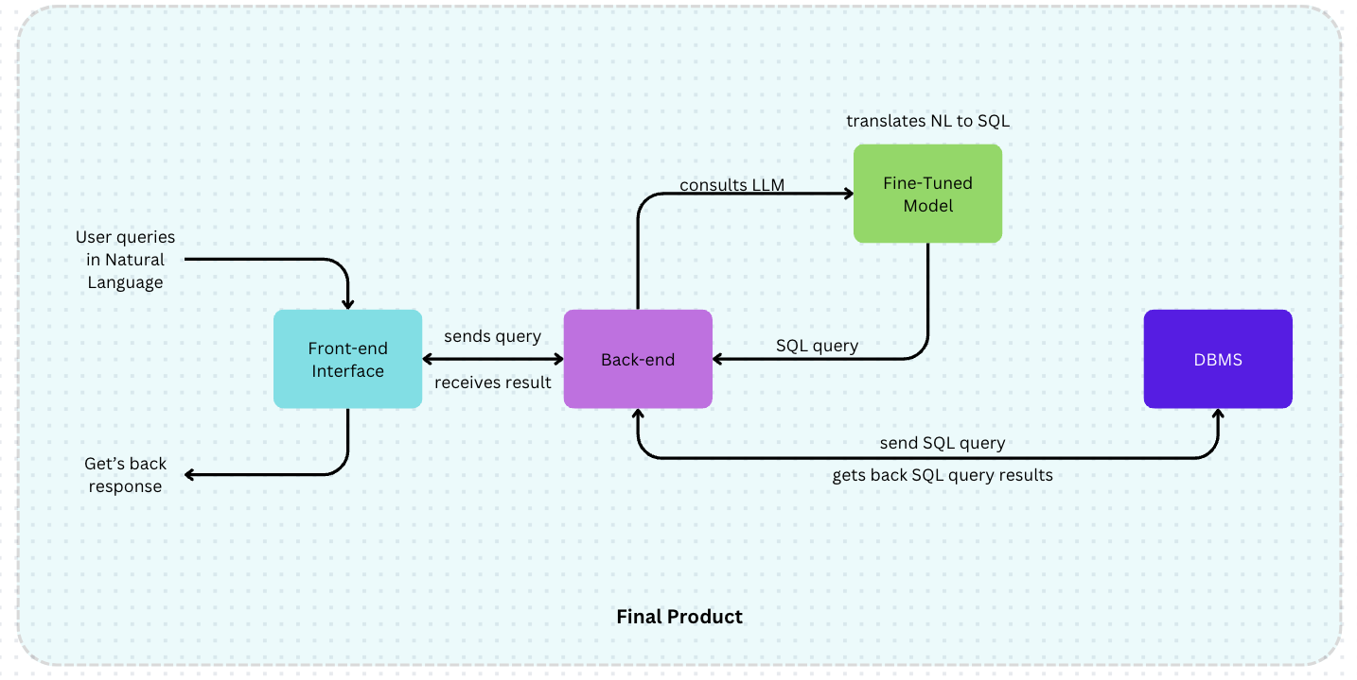

Slide 7
Per Week Work Plan
Datasets
Training
WEEK 02
WEEK 04
WEEK 01
WEEK 03
Models
Inferencing + Interfacing
Finding appropriate datasets to train our model on general SQL syntax
Training our model extensively on schema specific datasets after it has learnt the syntax
Finding appropriate models to train for generating queries along
Training the model on our own database to get query + data fetched from database

Slide 8
Datasets Used
We utilised the WikiSQL dataset for initially training the model to learn basic SQL syntax.
We then used the Spider dataset which contains queries along with schema so that the model could then learn schema specific generation. The modified dataset we used is available here.
We then wrote a large number of SQL queries on our database that featured SELECT operations of all varieties utilising JOIN and SORT operations, among others. This was the final training so that we could get accurate schema specific queries so that we can run them on PostgreSQL to get the results.

Slide 9
Model Used
We chose to use the open source LLM google/flan-t5-base available on huggingface to finetune for this task. It is an encoder-decoder model, with 12 encoder and 12 decoder layers. It has 248M parameters. The LLM is already popular for the task of question-answering so this is a naturally progressive task for the model.

Slide 10
Training Procedure
The training procedure was carried out as follows:
The initial fine tuning on WikiSQL dataset with a total size of 84K samples was carried out for nearly 3 epochs to obtain a rouge score of 0.52, we used PyTorch trainer for training the model. (link to model)
The second round of training was carried out on Spider dataset with a total size of 5K samples upto 4 epochs to seed model with schemas along with text queries.
The last round of training for nearly 2 epochs was carried out on our custom dataset with nearly 1000 handwritten queries on our database schema. The model finally settled at a rouge score of
0.7 on our database (link to model).

Slide 11
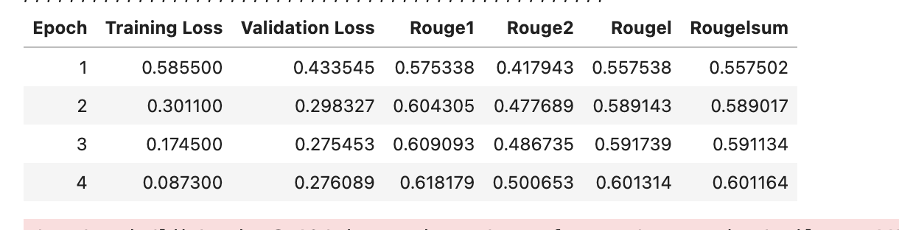
Training Results
After training on the spider dataset for 4 epochs:

Slide 12
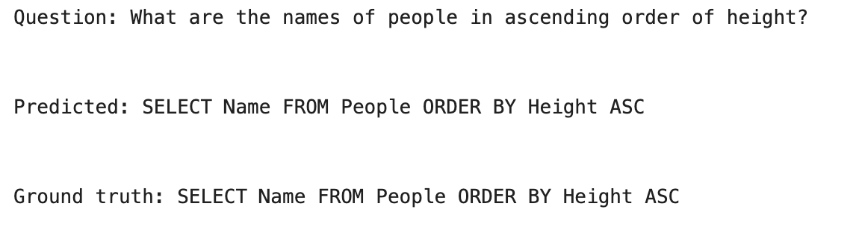
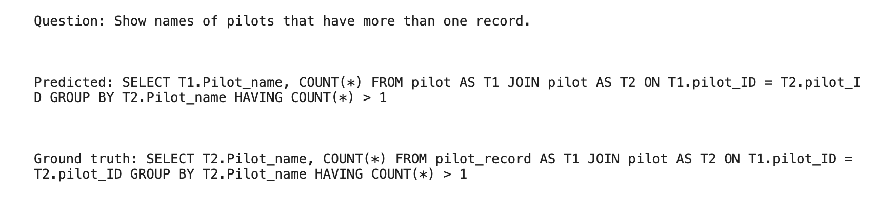
Training Results (Inference)
Here are some sample generations after the Spider training:

Slide 13
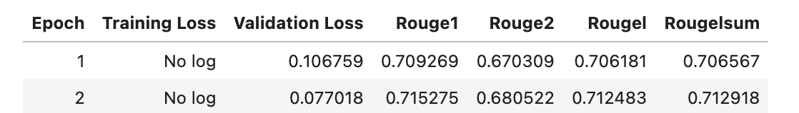
Final Training on Our Database
The last training was done on just 500 samples specific to our dataset for 2 epochs and the results are as shown :

Slide 14
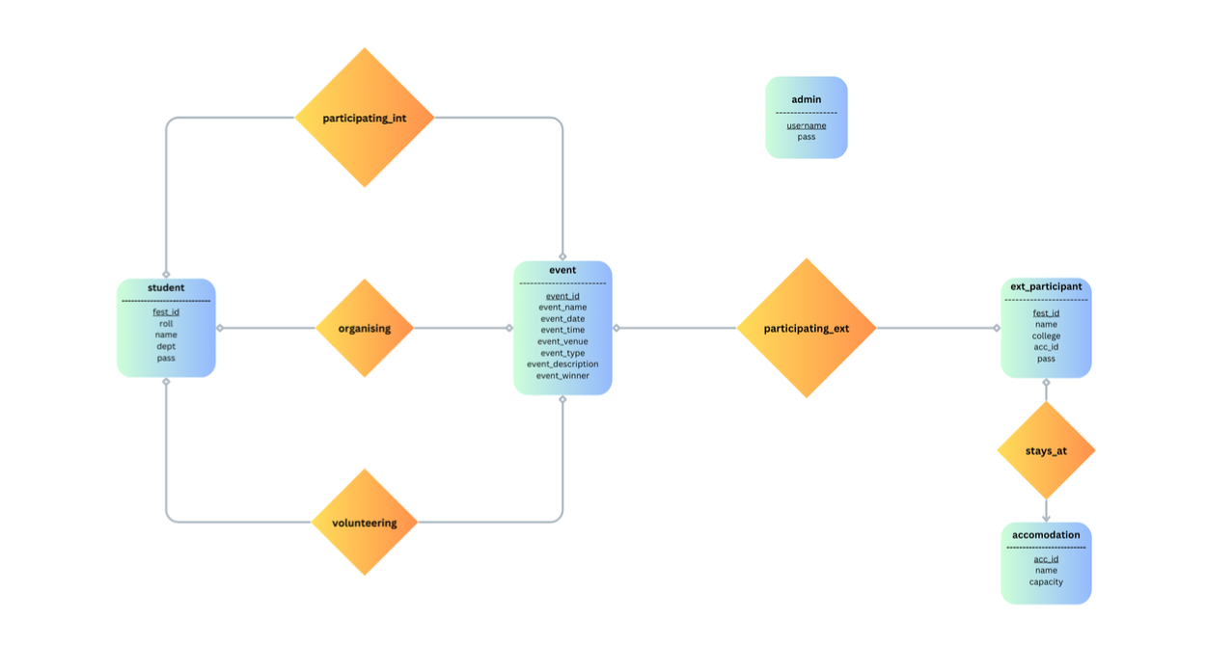
ER Diagram

Slide 15
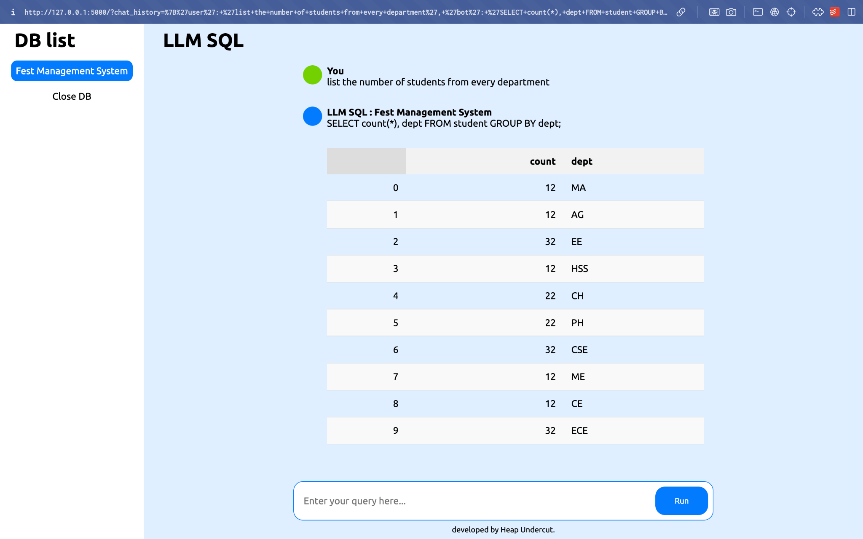

Slide 16
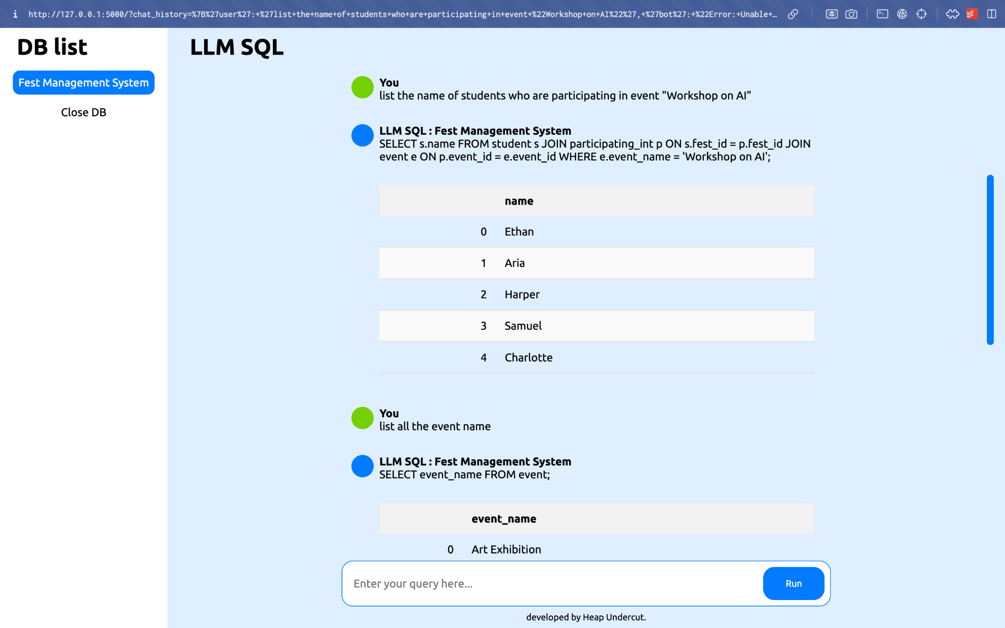
Inference Results (cont.)

Slide 17
DEMO

Slide 18
Limitations
Model tries to make up attributes and table names sometimes if the question is not framed properly.
Model query outputs are not very accurate as per SQL syntax which leads to some queries not getting proper data output.
Similar questions written in a different tone can lead to different query outputs.

Slide 19
Conclusion
In this project, we explored the potential of training a general LLM to generate accurate and relevant SQL queries. We primarily used the WikiSQL and the Spider datasets for large corpus of general SQL queries and then further fine tuned on our own database.

Slide 20
References
Here is a list of all references we used for this project:
Datasets: WikiSQL (modified), Spider (modified), FestDB
HuggingFace: Inference API and Models
Wikipedia

Slide 21
THANK YOU!

